Slide 1

딥러닝 (Deep Learning)
Homework 1
Deep Learning Basic

Slide 2

Programming assignments
Deep Learning Basic MLP
Object Recognition ResNet
Face Recognition Free choice model
Object Detection YOLO
Image Generation GAN, CGAN, DCGAN
NLU CNN for Sentence Classification
NLG LSTM, Transformer
SSL for Computer Vision ViT
SSL for NLP BERT
LLM ChatGPT

Slide 3
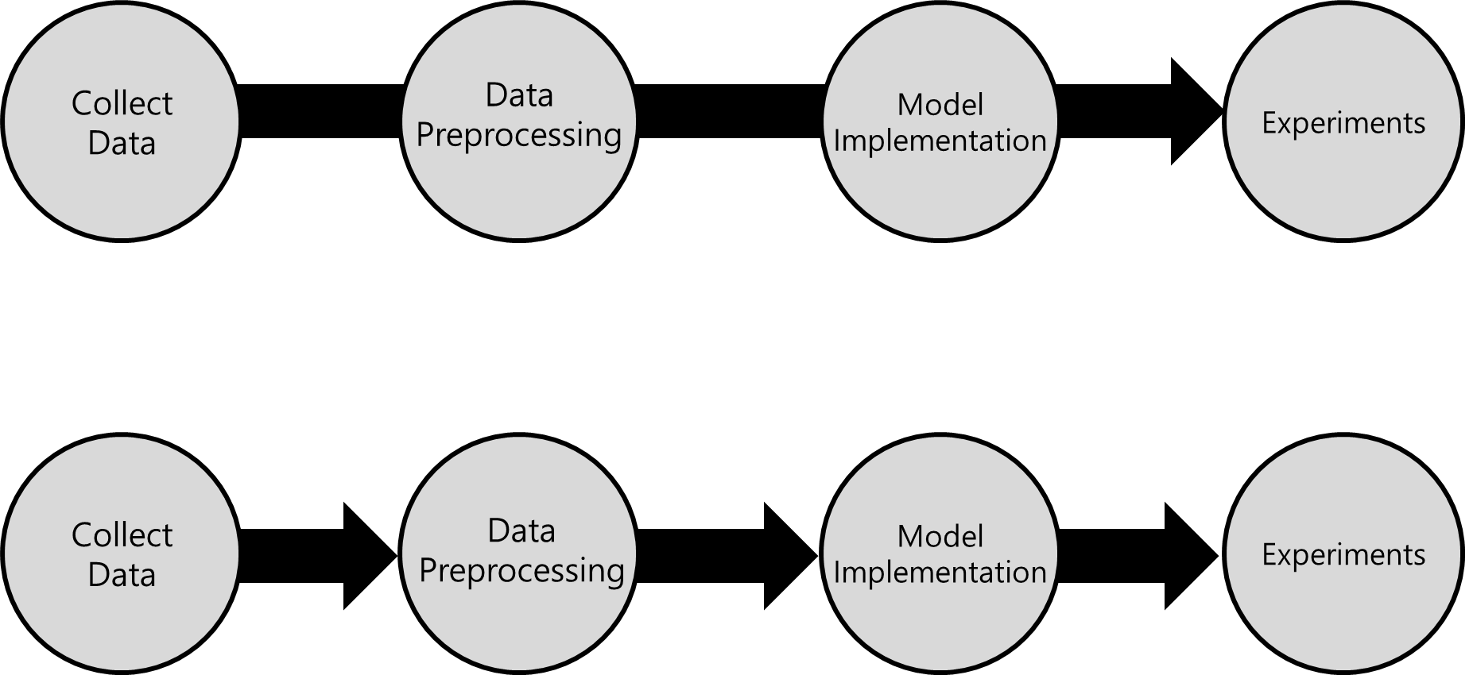
DeepLearning Research Code
각 단계가 독립적이 되도록 코드를 구현하고,
각 단계별 사이사이에 일정한 포맷(인터페이스)를 만들면서 구현

Slide 4
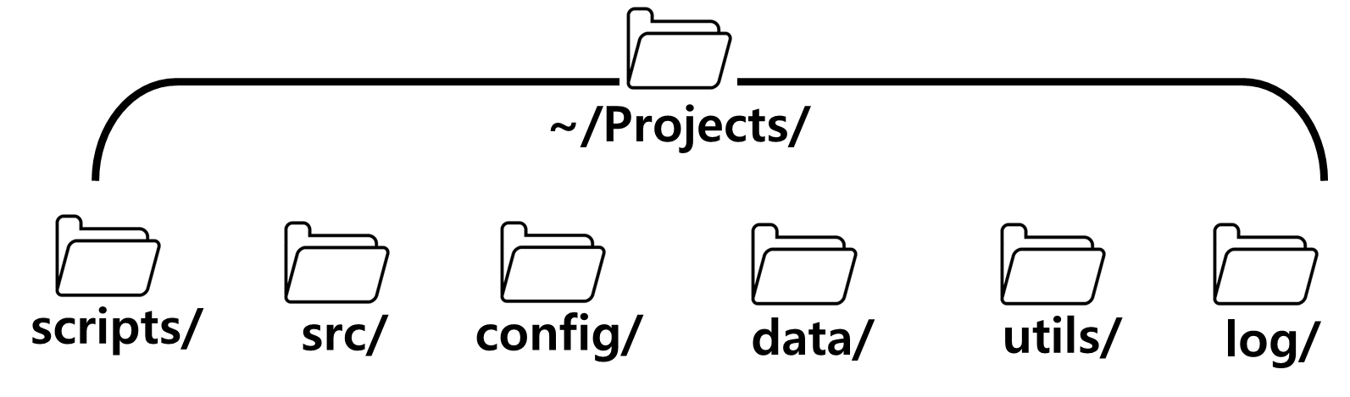
DeepLearning Research Code
Recommended Code Structure

Slide 5
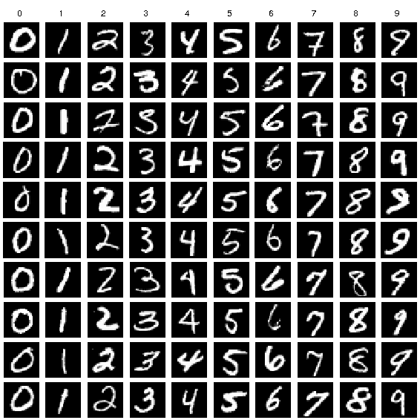
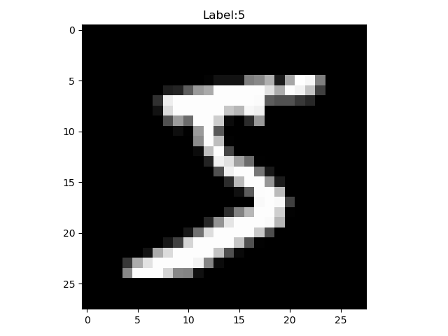
MNIST
MNIST: Modified National Institute of Standards and Technology database
Use very extensively for training and evaluating in the field of machine learning
Number of images for training: 60,000
Number of images for evaluation: 10,000
Shape of each data: [28, 28]
Channel: 1 (gray)
Range: 0 ~ 9 (10)

Slide 6
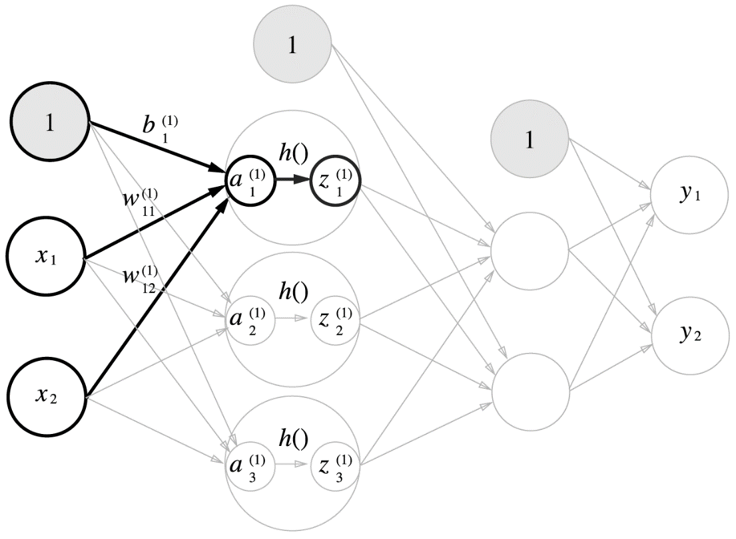
MLP model (Affine, Activation) – models/mlp.py
[Objective]
Your model should classify of the images into 10 classes (0~9).
class MNIST_model(nn.Module):
def __init__(self):
super().__init__()
self.fc1 = nn.Linear(28 * 28, 300)
self.fc2 = nn.Linear(300, 200)
self.fc3 = nn.Linear(200, 10)
def forward(self, x):
out = F.relu(self.fc1(x))
out = F.relu(self.fc2(out))
out = self.fc3(out)
return out
(784, 300)
(300, 200)
(200, 10)
ReLU

Slide 7
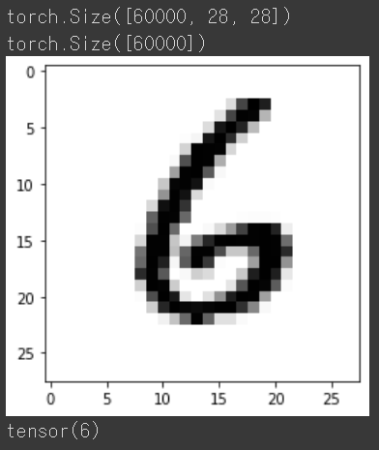
MLP model (MNIST Dataset)
# MNIST datset: 28 * 28 사이즈의 이미지들을 가진 dataset
mnist = torchvision.datasets.MNIST(root='./data', train=True, download=True)
# shape 및 실제 데이터 확인
print(mnist.data.size())
print(mnist.targets.size())
num = 6000
plt.imshow(mnist.data[num],cmap="Greys",interpolation="nearest")
plt.show()
print(mnist.targets[num])

Slide 8
MLP model (Dataset, DataLoader) – scripts/train_mlp.py
# 파이토치에서 제공하는 MNIST dataset
train_dataset = torchvision.datasets.MNIST(root='./data',train=True, transform=transforms.ToTensor(), download=True)
# data 개수 확인
print('The number of training data : ', len(train_dataset))
# 배치 단위로 네트워크에 데이터를 넘겨주는 Data loader
train_loader = torch.utils.data.DataLoader(dataset=train_dataset, batch_size=params[‘batch_size’],shuffle=True)

Slide 9
MLP model (Hyper-parameters) – config/mnist_mlp.yaml
# 데이터셋 task: MNIST model: DNN batch_size: 64 # 초기화 random_seed: 54321 # 레귤러리제이션 dropout_rate: 0.5 l2_reg_lambda: 1.0e-4 optimizer: adam lr: 1.0e-3 # 트레이닝 프로세스 max_epochs: 30

Slide 10
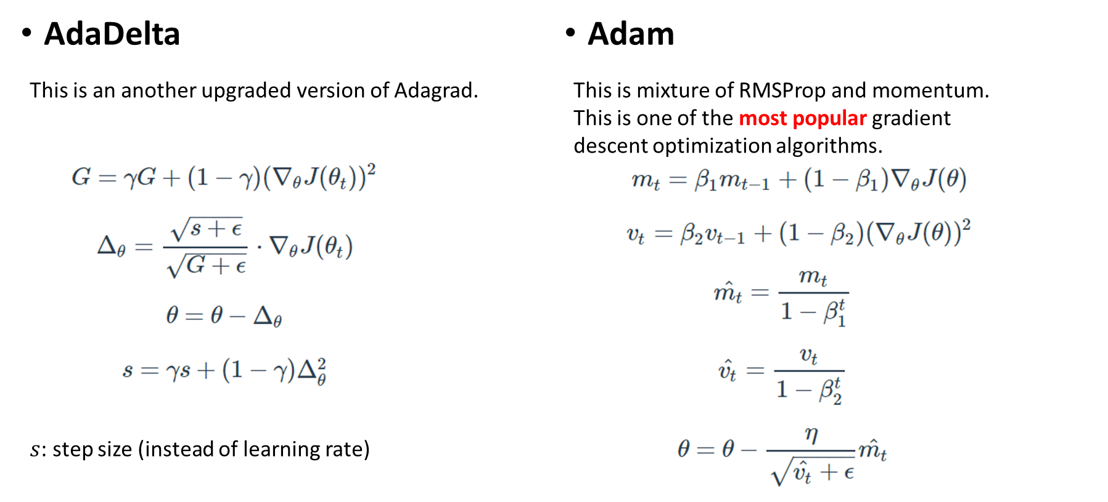
MLP model (Loss Function) – scripts/train_mlp.py
criterion = nn.CrossEntropyLoss()
optimizer = torch.optim.Adam(model.parameters(), lr=params[‘lr’])

Slide 11
MLP training
for epoch in range(params[‘max_epochs’]):
train_correct_cnt = 0
train_loss = 0
train_batch_cnt = 0
model.train()
for img, label in train_loader:
img = img.to(device)
label = label.to(device)
optimizer.zero_grad()
pred = model.forward(img.view(-1, 28 * 28))
loss = criterion(pred, label)
loss.backward()
optimizer.step()
train_loss += loss.item()
train_batch_cnt += 1
_, top_pred = torch.topk(pred, k=1, dim=-1)
top_pred = top_pred.squeeze(dim=1)
train_correct_cnt += int(torch.sum(top_pred == label))
train_acc = train_correct_cnt / len(train_dataset) * 100
train_ave_loss = train_loss / train_batch_cnt
training_time = (time.time() - start_time) / 60

Slide 12
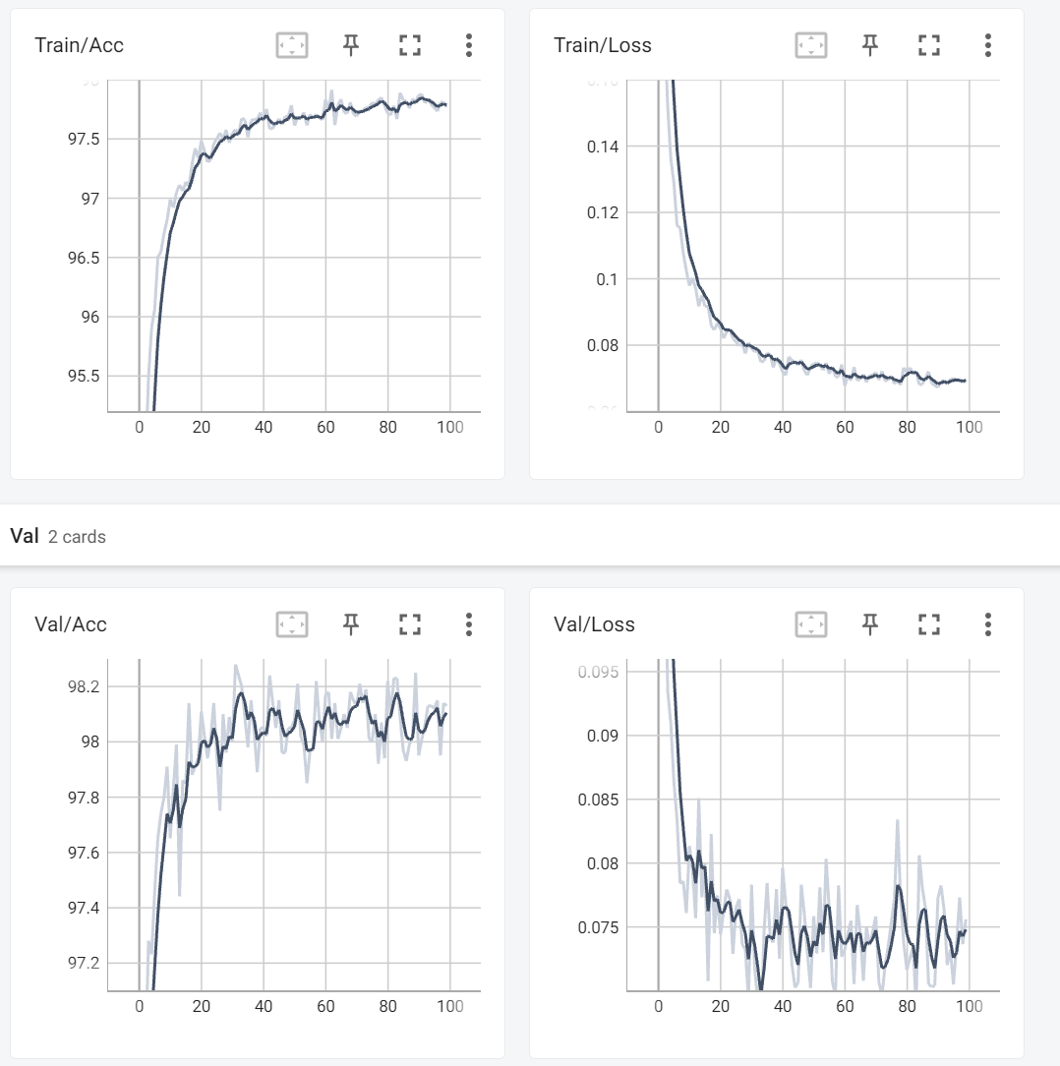
Accuracy, loss plot
D:\python\envs\Torch2022\Scripts>
./tensorboard --logdir=D:\python\workspace\DL_Lecture\scripts\runs\1711587583

Slide 13
MLP evaluation – scripts/eval_mlp.py
checkpoint_dir = os.path.abspath(os.path.join(out_dir, "checkpoints/best.pth")) checkpoint = torch.load(checkpoint_dir) model.load_state_dict(checkpoint['model_state_dict']) correct_cnt = 0 iter = 0 for x, y in test_loader: x = x.to(device) y = y.to(device) pred = model.forward(x.view(-1, 28 * 28)) _, top_pred = torch.topk(pred, k=1, dim=-1) top_pred = top_pred.squeeze(dim=1) correct_cnt += int(torch.sum(top_pred == y)) if iter == 0: total_pred = top_pred total_y = y total_pred = torch.cat((total_pred, top_pred)) total_y = torch.cat((total_y, y)) iter += 1 accuracy = correct_cnt / len(mnist_test_dataset) * 100 print("test accuracy: %.2f%%" % accuracy)

Slide 14
Homework 1: MLP
[Objective]
Your model should classify the images into 10 classes (0~9).
[Requirements]
1. Implement 4-layer perceptron with PyTorch.
(Basic code is provided)
2. You should experiment with the settings stated in the evaluation report and report the result of each setting.
3. You should attach the plot of the validation dataset accuracy plot.
4. You should report the experimental results.
(all kinds of additional experiments are recommended)
model
"5!"

Slide 15
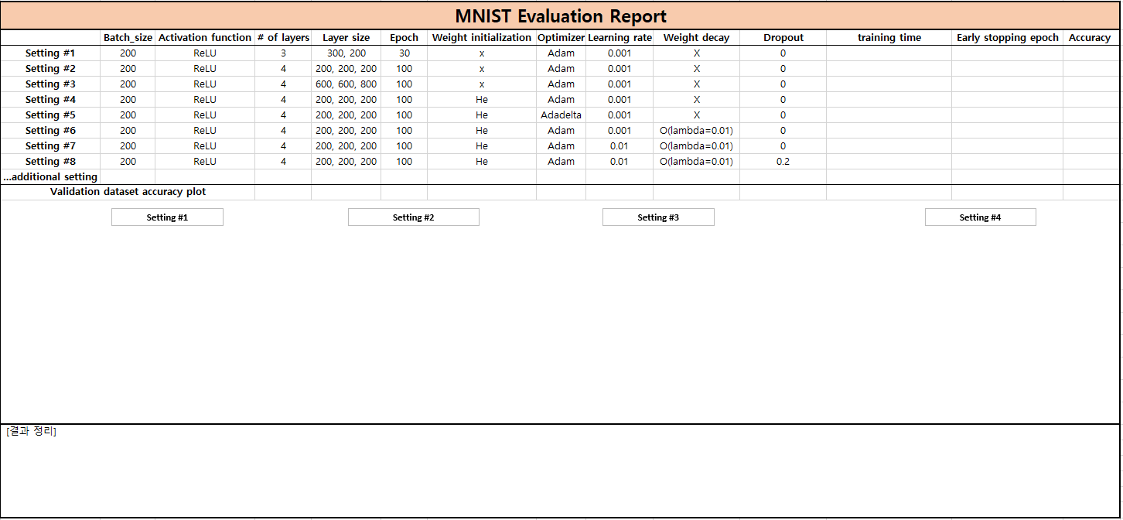
Homework 1: MLP
[Evaluation report]

Slide 16
Homework 1: MLP
Evaluation Criteria
Simplicity | How concisely did you write the code? - 배점 3.5점 4 Layers: 1점 Dropout: 1점 He initialization: 1점 Early stopping (1 epoch -> 100 iteration): 0.5점
Performance | How well did the results of the code perform? - 배점 1점 - acc 98.5%이상 달성 시 만점
Brevity and Clarity | How concisely and clearly did you explain the results? - 배점 0.5점

Slide 17
Homework 1: MLP
Due to : ~ 3/26(Wed) 23:59:59
Submission : Online submission on cybercampus
Your submission should include
The whole code of your implementation
The evaluation report
You must implement the components yourself!
File name : StudentID_Name_HW1.zip

Slide 18
Q&A

